Slide 1

NFL Approximate Value Analysis
Jack Molinaro

Slide 2
Topic Area/Initial Hypotheses
2016 National Football League (NFL) draft class
All drafted players, and all UDFAs who played a snap in the NFL
Individual performance level calculated using Pro Football Reference’s Approximate Value (AV)
GOALS:
See if a model can be built to predict how a player performs in the NFL
Look at the relationships between combine measurements

Slide 3
Approximate Value (AV)
https://www.sports-reference.com/blog/approximate-value-methodology/
Created by PFR founder Doug Drinen, the Approximate Value (AV) method is an attempt to put a single number on the seasonal value of a player at any position from any year (since 1950).
Offense - Every team gets this many points to divvy up among its offensive players:
team_offense_points = 100 * (team offensive points per drive) / (league average offensive points per drive), where
offensive points per drive = (7*(rushTD+passTD) + 3*FG) / (rushTD + passTD + turnovers + punts + FGA)
Defense - team_defense_points = 100 * [ (1 + 2 M - M^2) / (2 M) ],
where M = (team defensive points allowed per drive) / (league average defensive points allowed per drive)
Returners – 1 point of AV for each kick or punt return TD

Slide 4
Explanatory Variables
Position
School
P5, G5, FCS, Other
College Games
Years at College
Left Early, 4 Yrs, More than 4, Other -> D1
Average Position Rank
Round Drafted
Position Number Drafted
Organization All-Pros at Position
Average Rookie Contract
First Start
Y1W1, Y1Other, Y2W1, Y2Other, AfterY2
Years since Team made Playoffs (2015)

Slide 5
Data Sources
https://www.pro-football-reference.com/
https://www.sbnation.com
https://www.spotrac.com/
https://www.footballdb.com/
https://bleacherreport.com/articles/2625340-2016-nfl-draft-big-board-matt-millers-top-400-overall-players
https://draftwire.usatoday.com/2016/04/27/2016-nfl-draft-final-top-300-big-board/
https://www.nfl.com/news/mike-mayock-s-2016-nfl-draft-top-100-prospect-rankings-0ap3000000655903
https://www.si.com/nfl/2016/04/12/nfl-draft-2016-position-rankings-players-prospects
https://nflcombineresults.com/
http://draftscout.com/

Slide 6
Summary Statistics
VARIABLE | Total AV | Avg Rookie Contract | School |  | First Start
MIN | 0 | 0.450 | P5 | 289 | Y1_W1 | 45
Q1 | 1 | 0.540 | G5 | 83 | Y1_Other | 142
MEDIAN | 4 | 0.610 | FCS | 46 | Y2_W1 | 23
MEAN | 9.53 | 0.8754 | Other | 15 | Y2_Other | 102
Q3 | 14 | 0.7325 | NA | 1 | After_Y2 | 122
MAX | 63 | 6.984

Slide 7
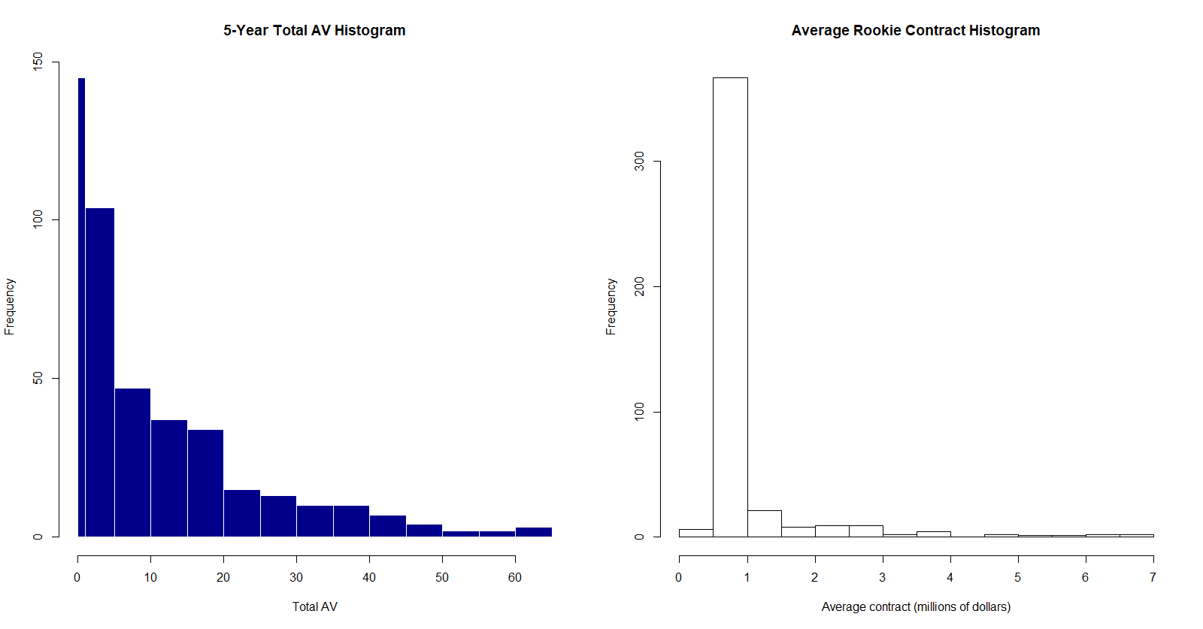
Histograms

Slide 8
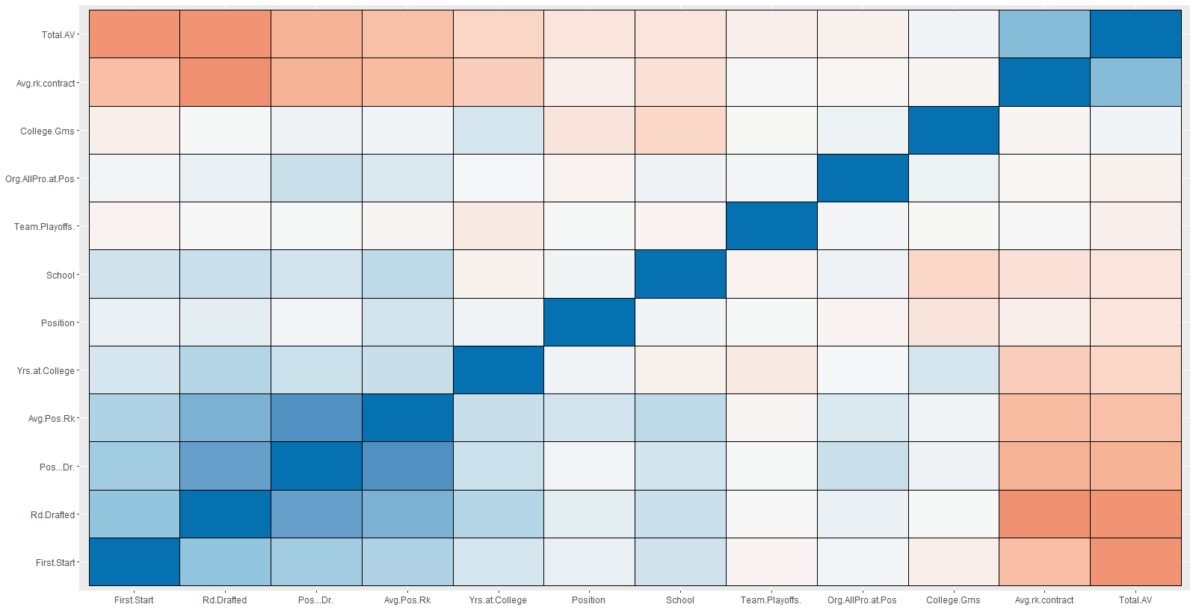
Correlation Matrix

Slide 9
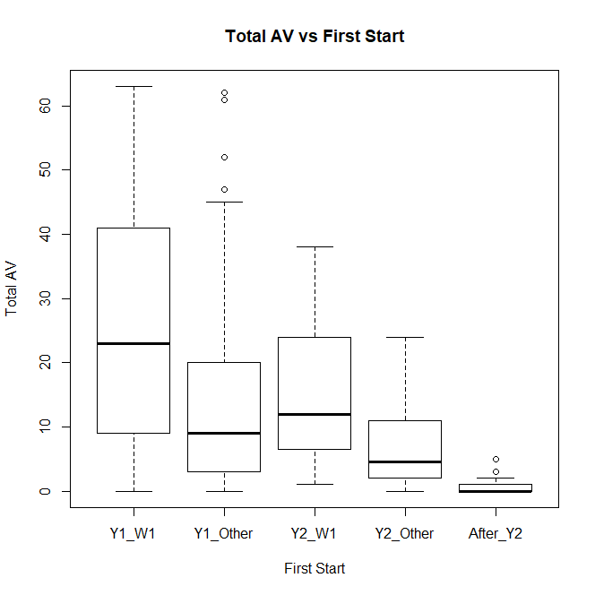
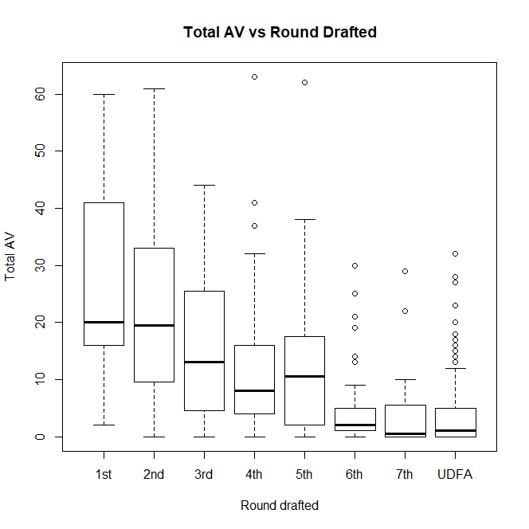
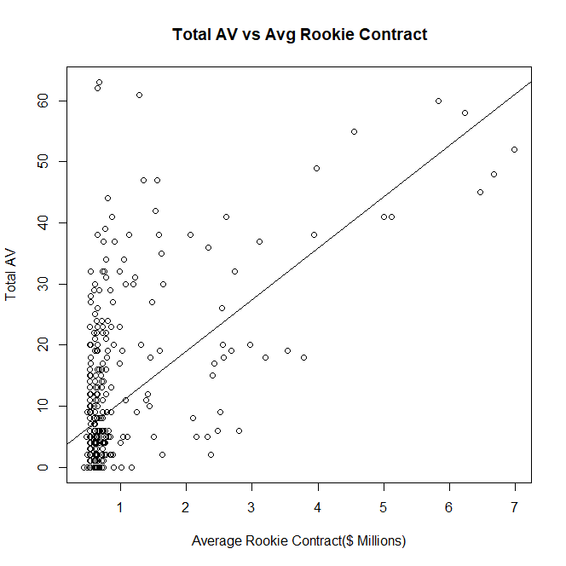
Plots – Response Variable

Slide 10
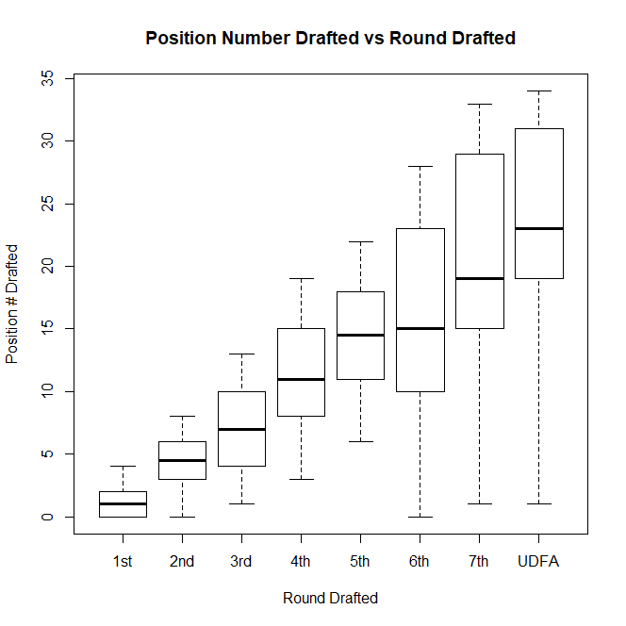
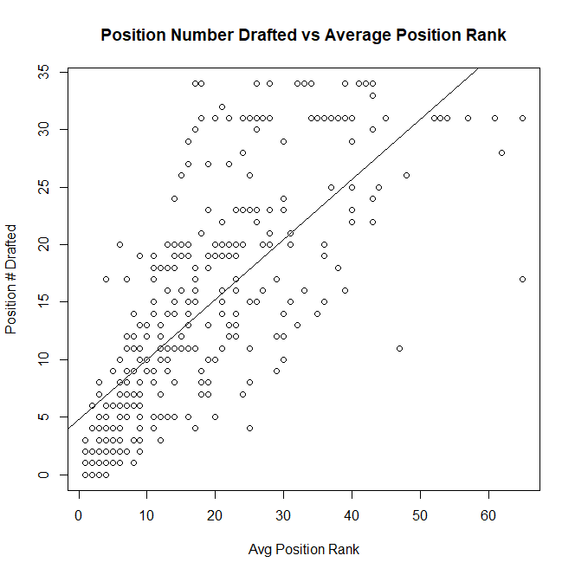
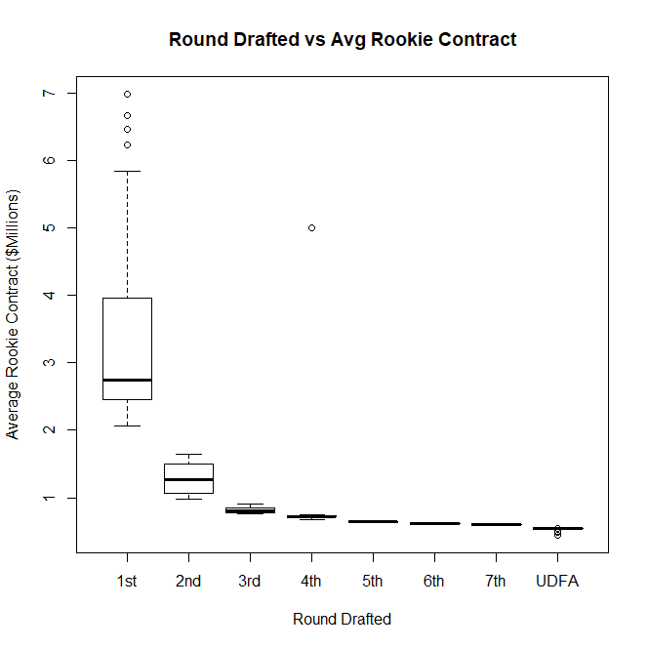
Plots – Explanatory Variables

Slide 11
Stepwise Selection
Step | Variable | Added/Removed | R-Square
1 | First Start | Added | 0.359
2 | Avg Rookie Contract | Added | 0.501
3 | Round Drafted | Added | 0.543
4 | Team Playoffs | Added | 0.547

Slide 12
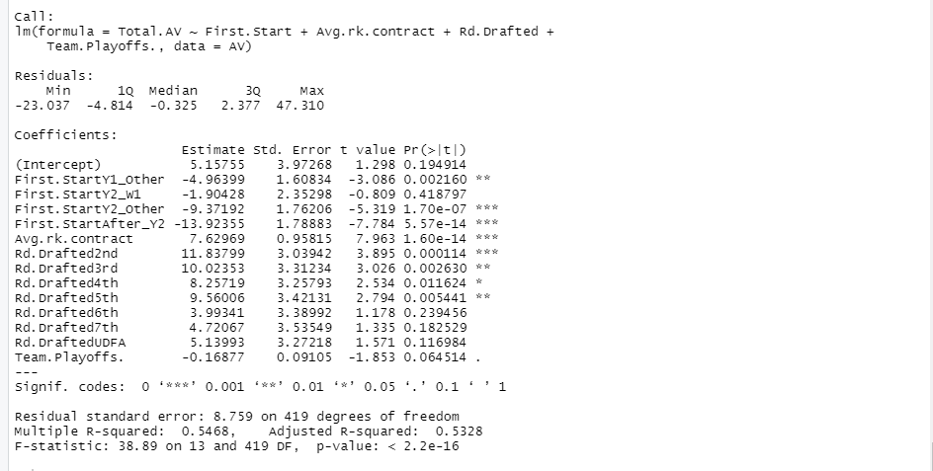
Regression Model

Slide 13
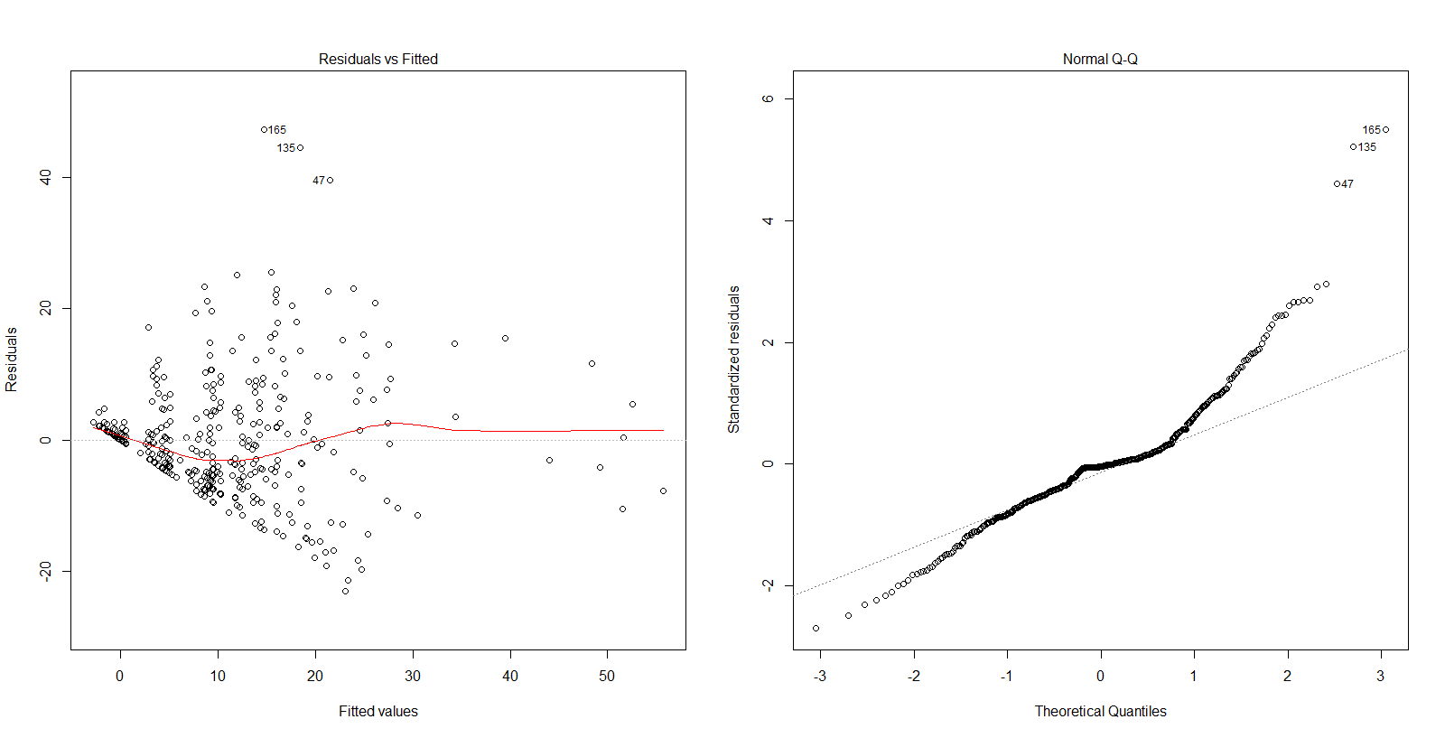
Residual Plots

Slide 14
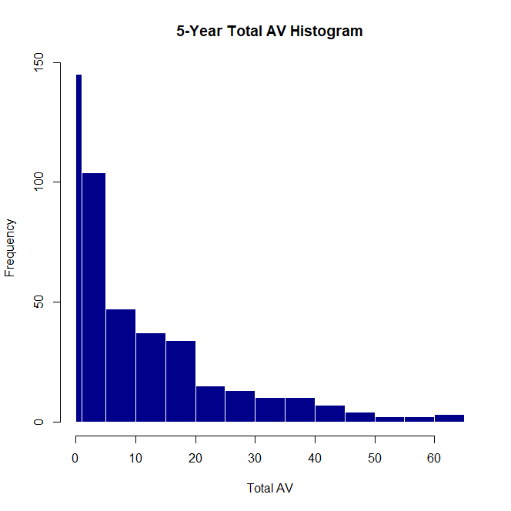
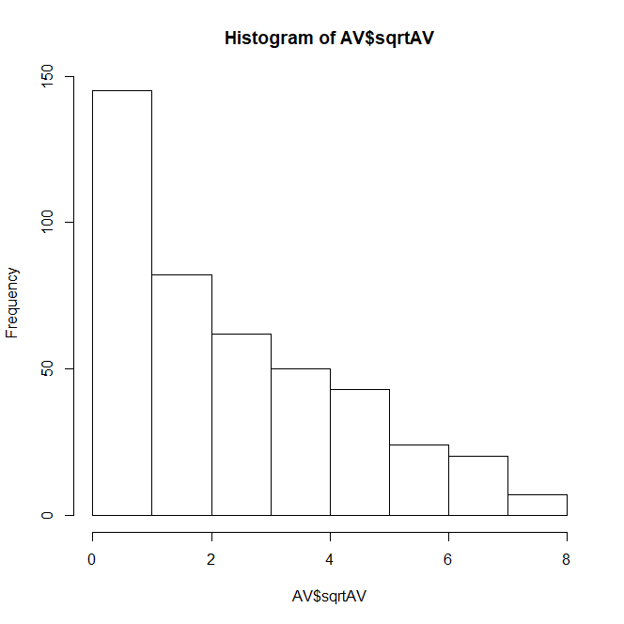
Transformation of Response Variable

Slide 15
Stepwise Selection
Step | Variable | Added/Removed | R-Square
1 | First Start | Added | 0.506
2 | Avg Rookie Contract | Added | 0.584
3 | Round Drafted | Added | 0.622
4 | Position | Added | 0.660
5 | Years at College | Added | 0.666

Slide 16
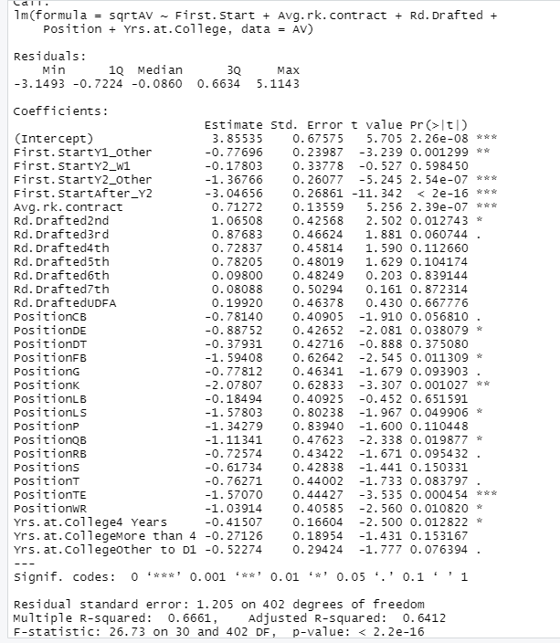
Regression Model

Slide 17
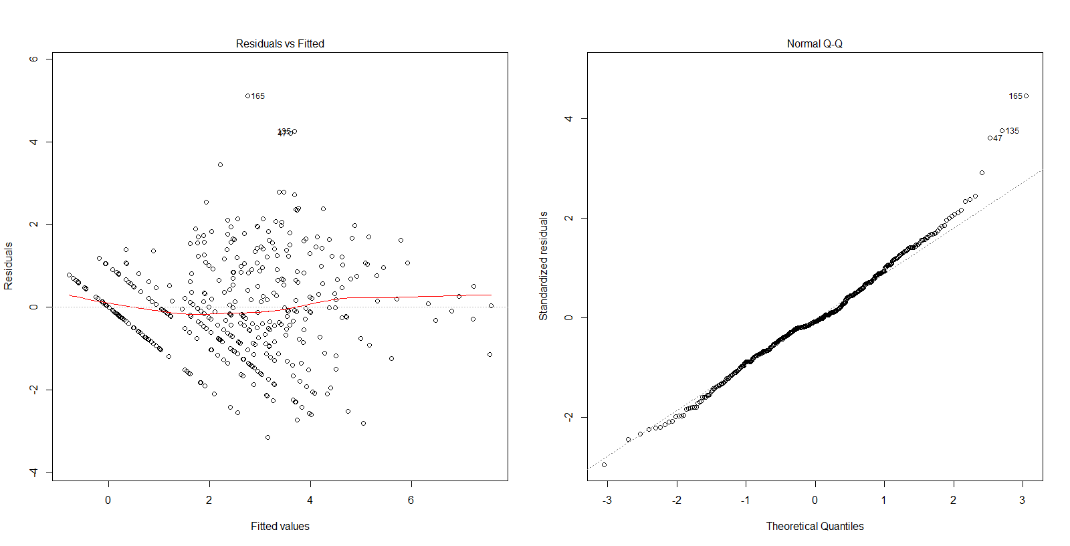
Residual Plots

Slide 18
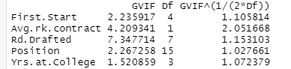
Multicollinearity

Slide 19
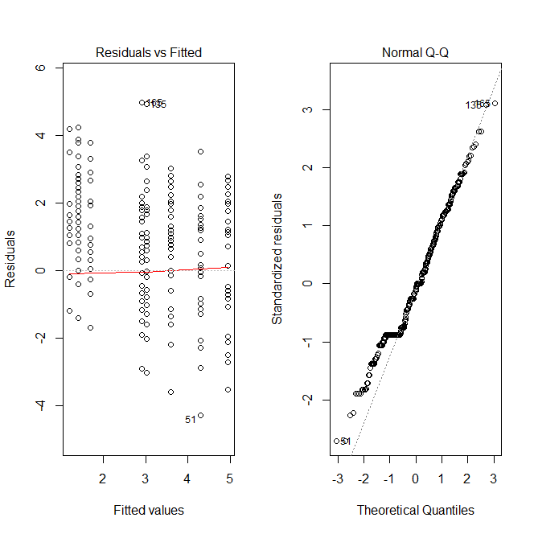
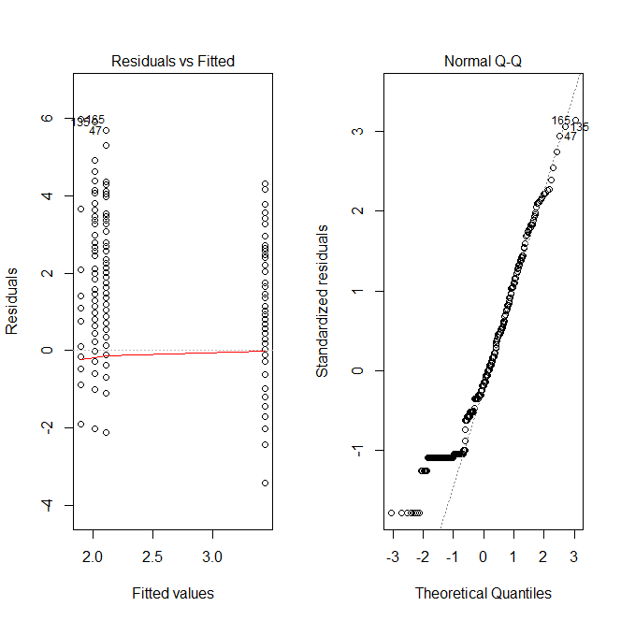
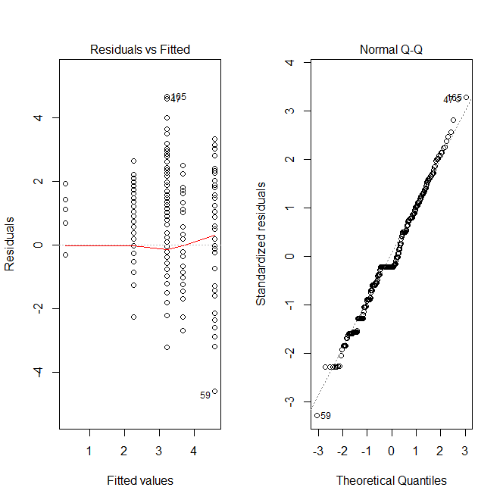
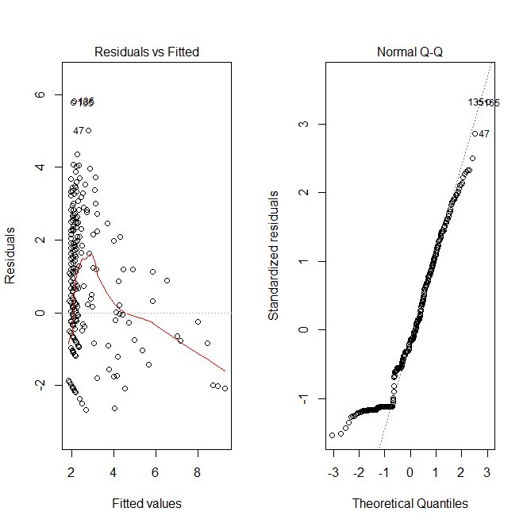
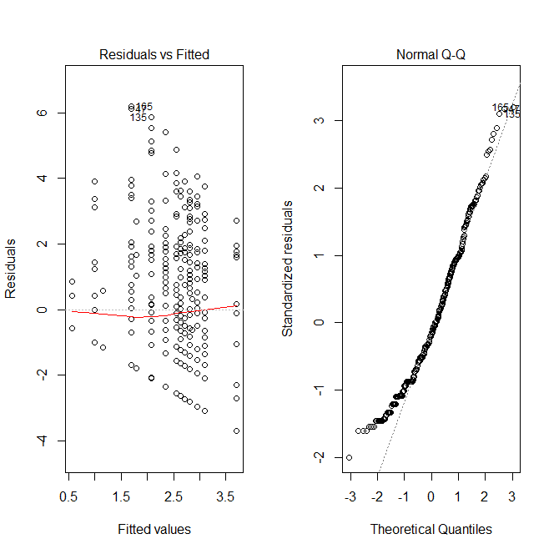
Residual Analysis
Round Drafted
Yrs in College
First Start
Avg Rk Contract
Position

Slide 20
Comparing Non-Zero AV Players vs Zero AV Players

Slide 21
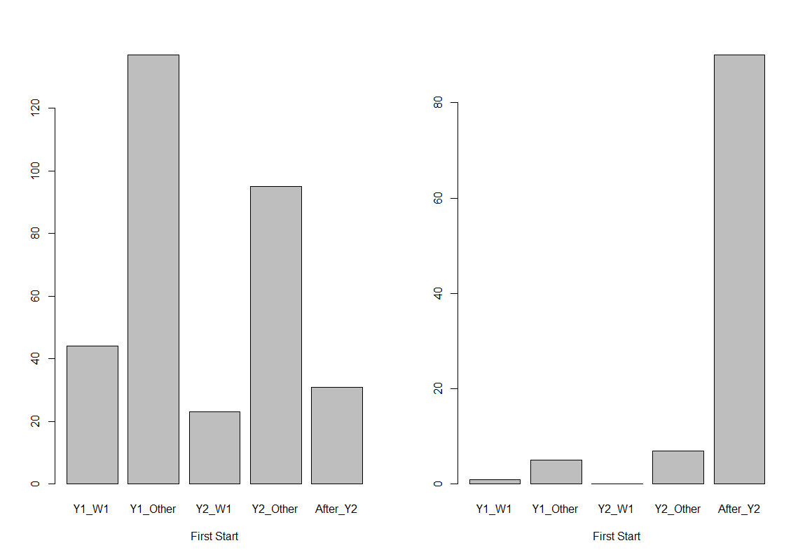
FIRST START | Non-Zero | Zero
Year 1, Week 1 | 44 (13.3%) | 1 (1.0%)
Year 1, Other | 137 (41.5%) | 5 (4.9%)
Year 2, Week 1 | 23 (7.0%) | 0 (0.0%)
Year 2, Other | 95 (28.8%) | 7 (6.8%)
After Year 2 | 31 (9.4%) | 90 (87.4%)
AVG RK CONTRACT | Non-Zero | Zero
MIN | 0.490 | 0.450
Q1 | 0.542 | 0.540
MEDIAN | 0.6825 | 0.540
MEAN | 0.9682 | 0.5806
Q3 | 0.7833 | 0.605
MAX | 6.984 | 1.165

Slide 22
FIRST START | Non-Zero | Zero
C | 10 | 1
CB | 47 | 10
DE | 26 | 8
DT | 34 | 3
FB | 3 | 3
G | 16 | 3
K | 3 | 3
LB | 46 | 7
LS | 2 | 1
P | 3 | 0
QB | 10 | 8
RB | 22 | 11
S | 30 | 3
T | 25 | 4
TE | 11 | 15
WR | 42 | 23
Round Drafted | Non-Zero | Zero
1st | 31 | 0
2nd | 30 | 2
3rd | 34 | 1
4th | 37 | 4
5th | 32 | 4
6th | 35 | 10
7th | 16 | 16
UDFA | 115 | 66
Years at College | Non-Zero | Zero
Left Early | 82 (24.8%) | 8 (7.8%)
4 Years | 141 (42.7%) | 55 (53.4%)
More than 4 | 89 (27.0%) | 34 (33.0%)
Other to D1 | 18 (5.5%) | 6 (5.8%)

Slide 23
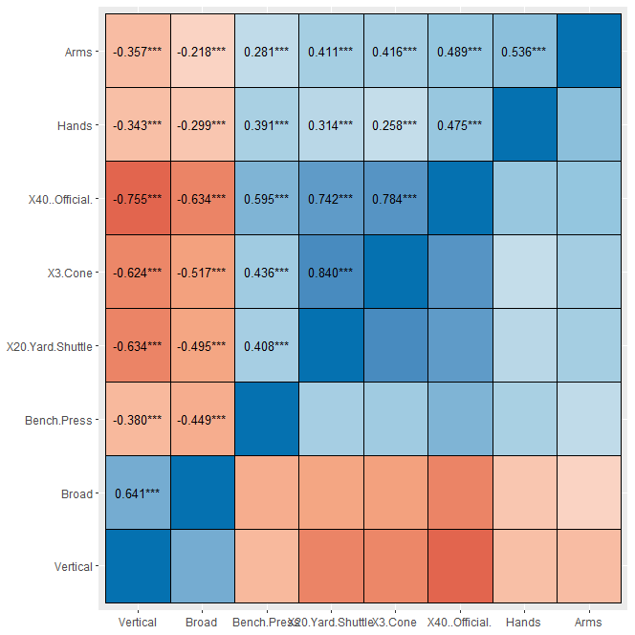
Combine Correlation Matrix

Slide 24
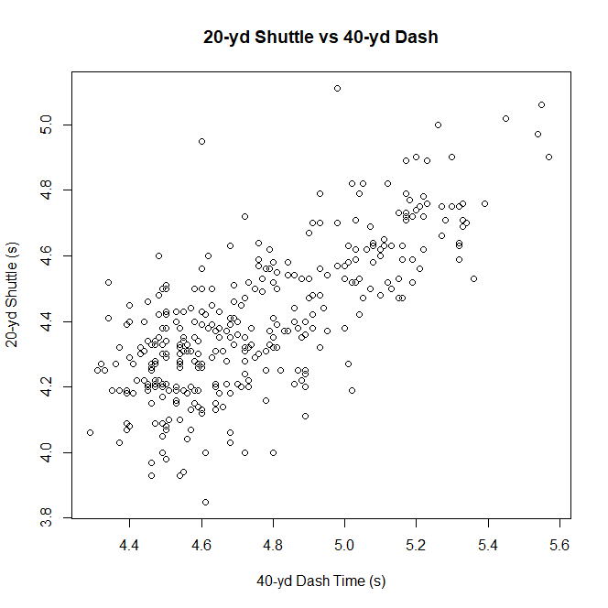
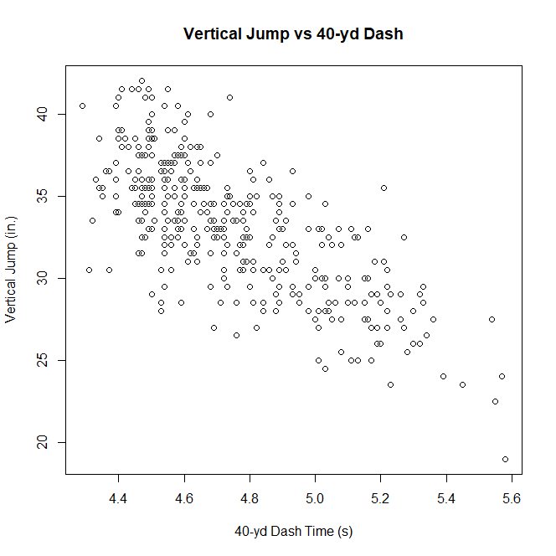
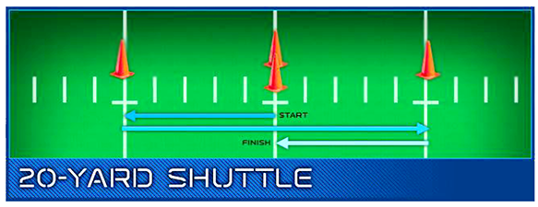
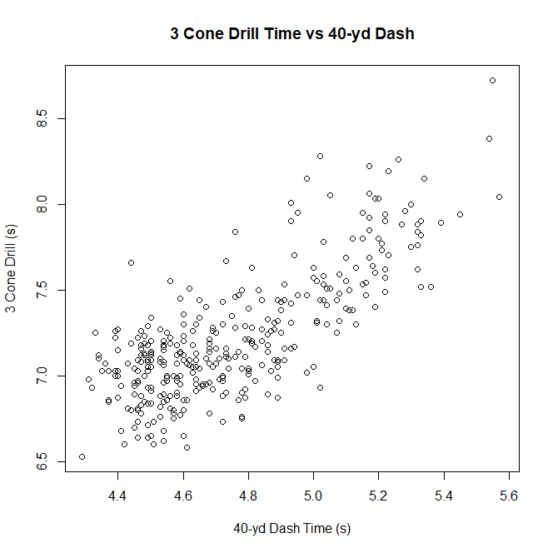
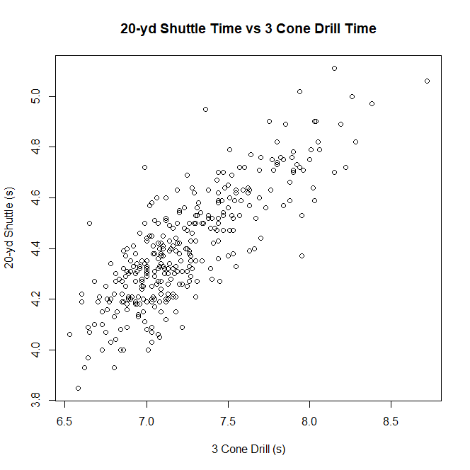
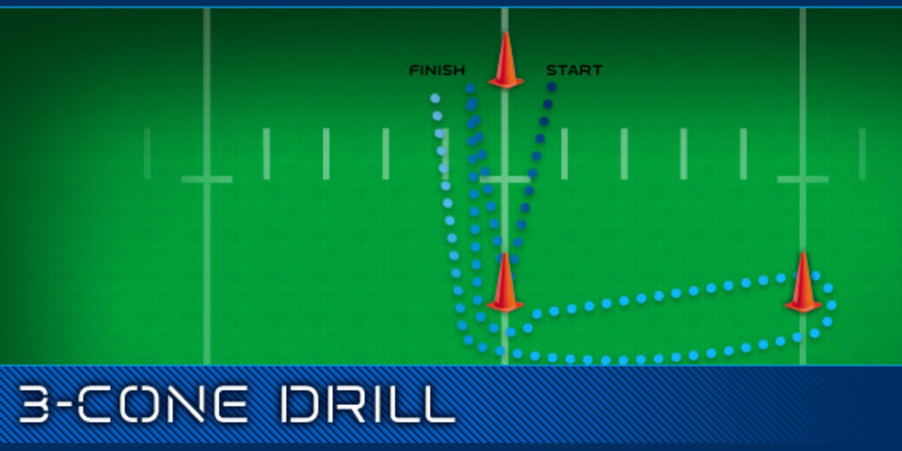
Combine Measurements

Slide 25
Next Steps
Look into zero-inflation model
Poisson Regression would not work
Find a source that has whether a player missed a game in college
Include height and weight in combine metrics
Compare drafted vs undrafted players
Focus on one (or a few) position(s)
Add specific statistics for the position(s)
Possibly compare across different years; add draft classes to the model

